Slide 2
Title: ASF Country situation and control efforts
Presenter: Paul Lumu on behalf of CVO, Dr. Anna Rose Ademun
Country and institution: Uganda, Ministry of Agriculture Animal industry and Fisheries

Slide 3
Background and introduction
The livestock subsector is one of Uganda’s crucial sectors with prospects of improving livelihoods of the rural poor.
Pig farming is one of the key enterprises for the Small holder farmers who are the majority in the Agricultural sector in Uganda.
In Uganda, the pig sector is largely dominated by smallholders, who collectively constitute more than 90% of the agricultural system.
Pig farming is one of the fastest growing livestock enterprises in Uganda, with 17.8% of households rearing pigs (UBOS, 2011).
By 2016, there were 4.0 million pigs and it’s the fastest growing livestock enterprises

Slide 4
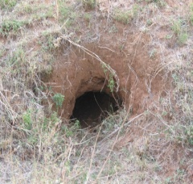
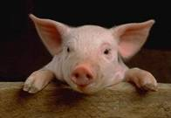
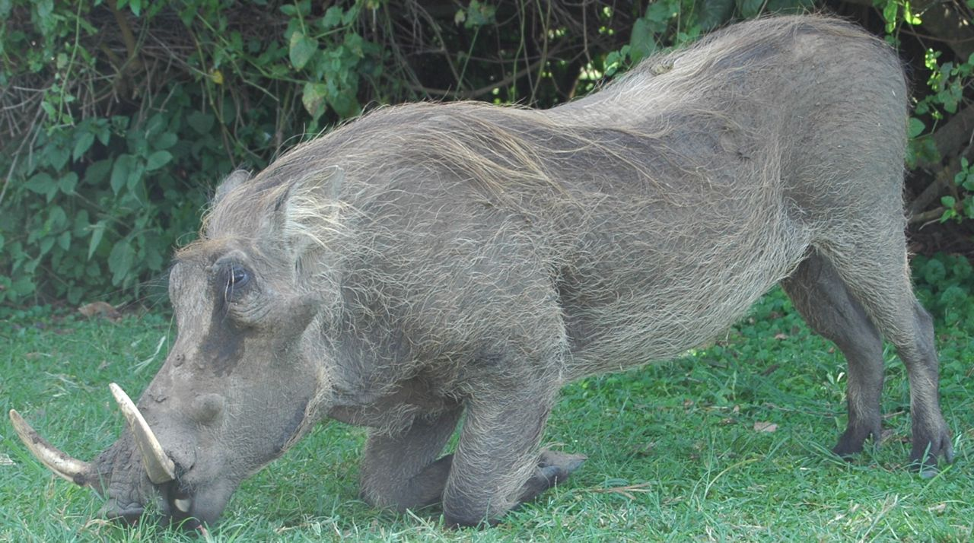
ASF epidemiology
Reservoir in soft ticks
Survival > three years recorded
Asymptomatic infection in warthogs and bushpigs
Two main mechanisms of transmission
Sylvatic: Ticks feed on warthogs to domestic pigs?
Current quantitative importance
unclear
The role of the bushpig? Refer to a study around Murchison NP
Domestic pig to pig cycle
particularly in urban & peri-urban areas???
perhaps the most important mode of transmission?
Where is the reservoir? (soft tick?)

Slide 5
Outbreaks of ASF in Uganda 2015-2021

Slide 6
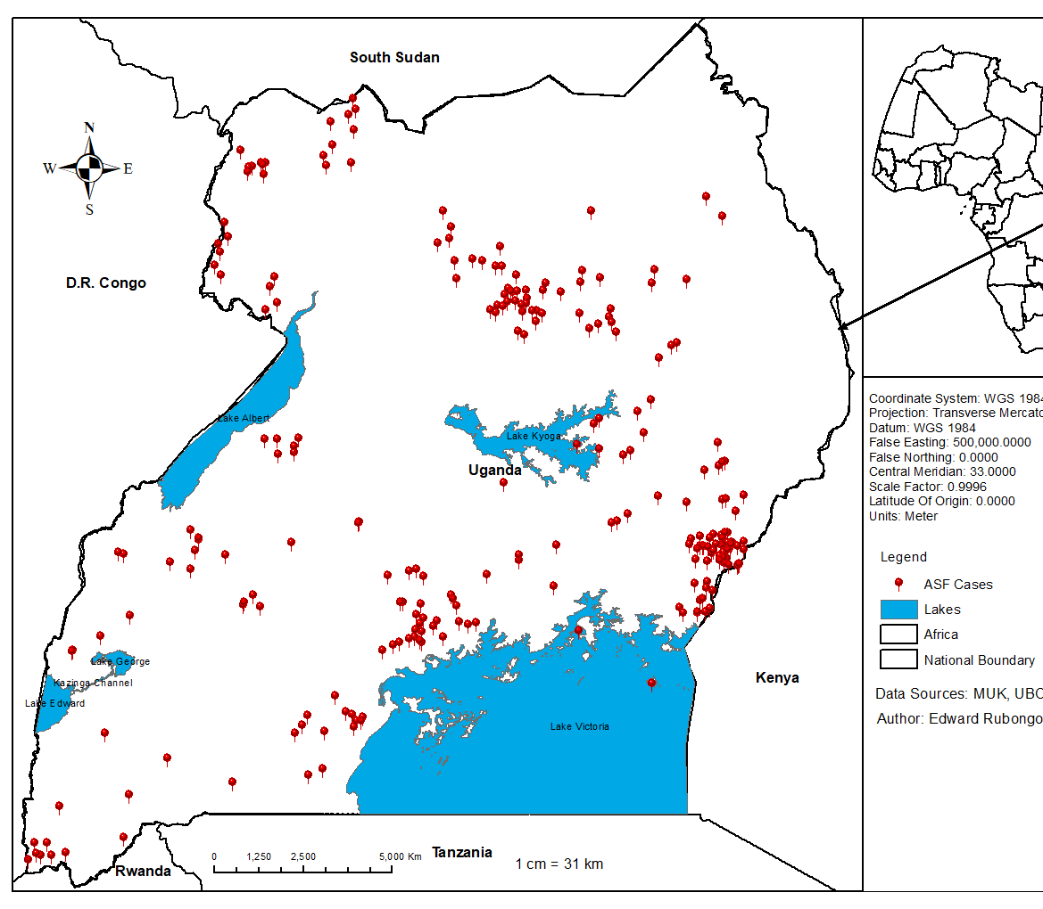
ASF cases, 2015 - 2021

Slide 7
Risk Factors Associated with spread of ASF & Interventions to minimize
Poor husbandry practices and poor on farm biosecurity measures (purchase of replacement stock without testing or initial isolation, sharing of breeding boars, free-range husbandry system and allowing access of visitors onto farms without disinfection)
Increased movements of pigs during suspected ASF outbreaks to mitigate losses by the farmers due to the disease.
.
Increased prevalence of the Vector
Feeding of Swill without taking the necessary precautions
Increased Wildlife-livestock interface due to the decreasing land availability hence encroachment to the protected areas

Slide 8
Interventions to minimize ASF Spread.
Instituting Movement restrictions where ASF outbreaks have been confirmed by PCR.
Destruction of the infected flock has been recommended but difficult to implement since there is no direct way of compensating the farmers.
Training of farmers on biosecurity measures especially in the hot spot areas by the Ministry, District Veterinarians, Community based organizations, NGOs, Pig farmer platforms, Press releases, Electronic Media.
Development of the ASF control strategy with support from FAO is underway.
Sourcing stock from disease free districts and farms (Screening).

Slide 9
On-going research
Next generation sequencing of the ASF viruses from outbreaks
Various efforts on vaccine development by consortium partners at Makerere, NARO, Gulu University

